Slide 1
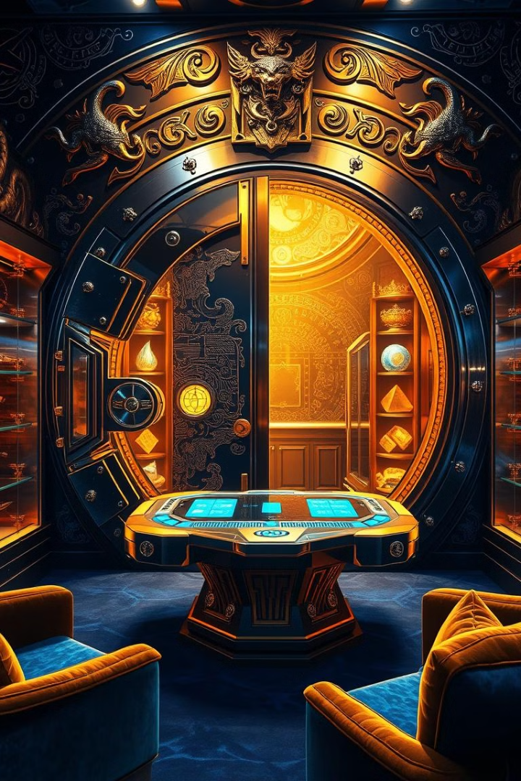
Gaming Vault: A Webstack Development Project
Welcome to Gaming Vault, a comprehensive platform that brings together the world of gaming enthusiasts. This project embodies a blend of webstack technologies, creating a user-friendly and immersive experience.
BY: Yash Sharma | Ayur Dekate | Darshan Agrawal

Slide 2
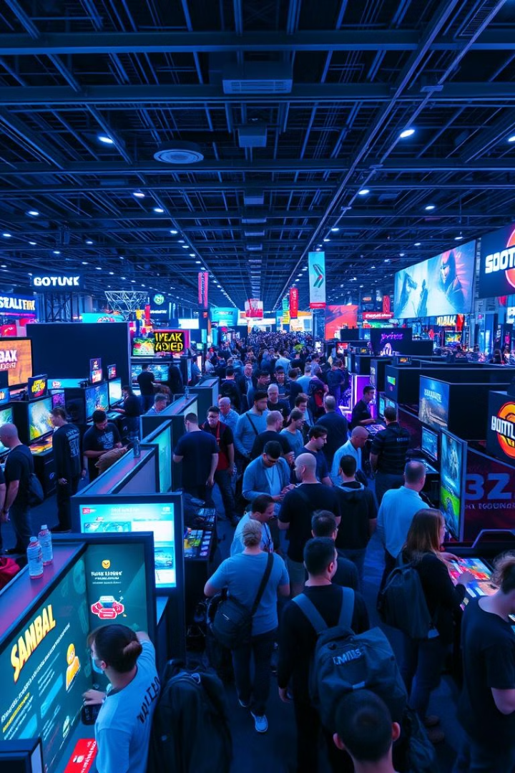
Overview of the Project
1
Bridging the Gap
2
User-Centric Design
Gaming Vault aims to bridge the gap between gamers of all levels, providing a platform for connection, information, and entertainment.
The project focuses on creating a user-friendly experience, prioritizing accessibility and intuitive navigation.
3
Comprehensive Resources
4
Interactive Features
Gaming Vault incorporates interactive features, such as a game library, leaderboards, and personalized profiles, enhancing user engagement.
The platform offers a wide range of resources, including game reviews, news, and community forums, catering to diverse gaming interests.

Slide 3
Functionality and Technologies Used
1
User Interface
The user interface is designed to be visually appealing and easy to navigate, providing a seamless experience.
2
User Authentication
Secure login and registration systems ensure user privacy and protect account information.
3
Dynamic Content
The website dynamically updates content, ensuring fresh information and relevant updates for users.
4
Game Data Integration
Fetch API retrieves and displays real-time game data, keeping users informed about the latest releases and trends.
5
Community Features
Community features, such as forums and chat rooms, allow users to connect and share their gaming experiences.

Slide 4
Tailwind CSS and Bootstrap Integration
Tailwind CSS
Bootstrap Framework
Synergy of Frameworks
Tailwind CSS provides a utility-first approach to styling, enabling rapid development and flexibility.
Bootstrap provides pre-built components and responsive layouts, streamlining development and ensuring a consistent user experience.
The integration of Tailwind CSS and Bootstrap creates a powerful combination, allowing for highly customized and visually appealing designs.

Slide 5
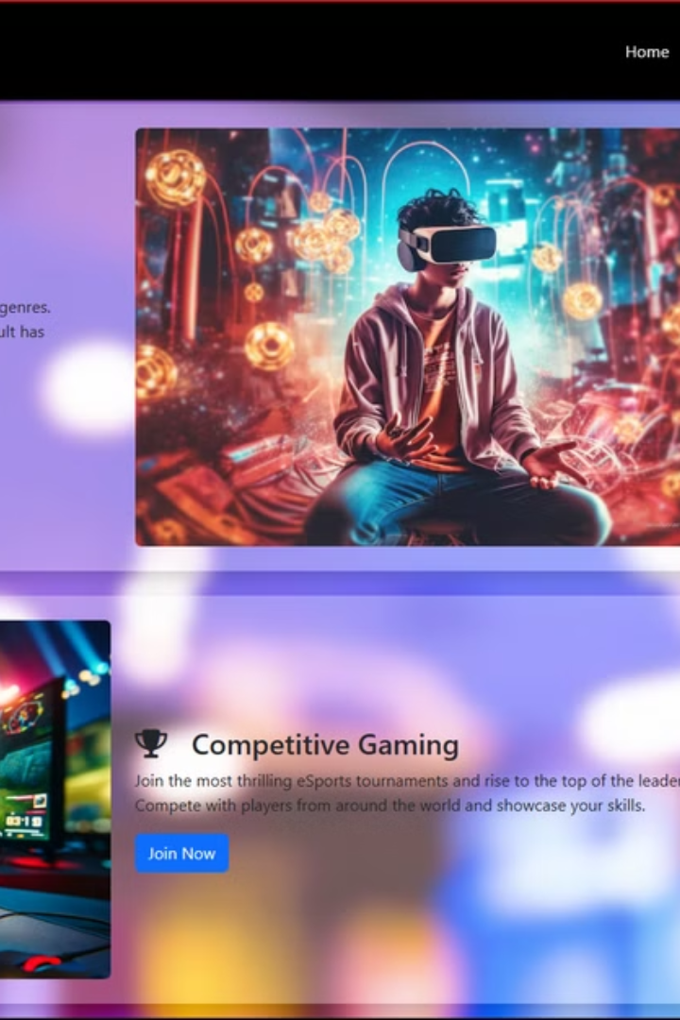



Navbar, Carousel, and Grid Layout
Navbar
The navbar serves as the main navigation menu, providing access to key website features.
Carousel
The carousel dynamically displays featured games, highlighting popular titles and new releases.
Grid Layout
The grid layout organizes content effectively, providing a clean and visually appealing presentation.

Slide 6
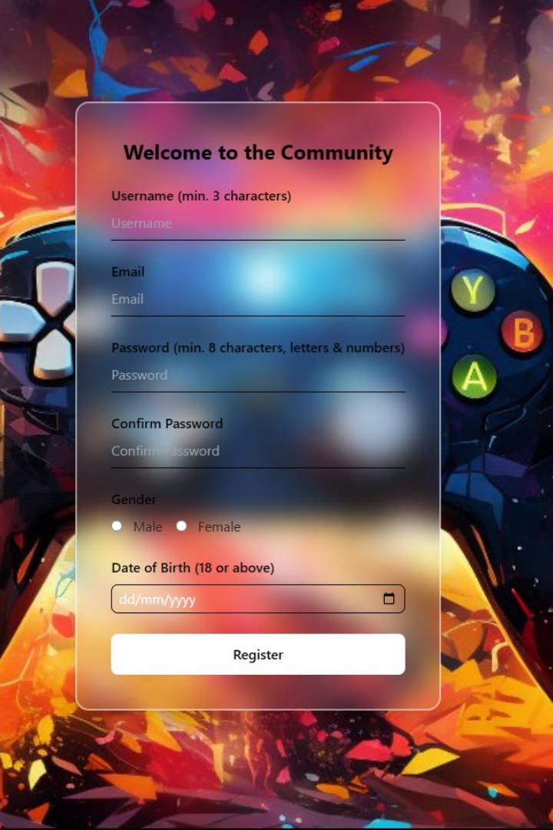
Login and Registration Forms with Validation
Feature
Description
Login Form
Allows users to access their accounts with secure authentication.
Registration Form
Enables new users to create accounts, providing personalized experiences.
Form Validation
Ensures data integrity and prevents errors by validating user input.

Slide 7
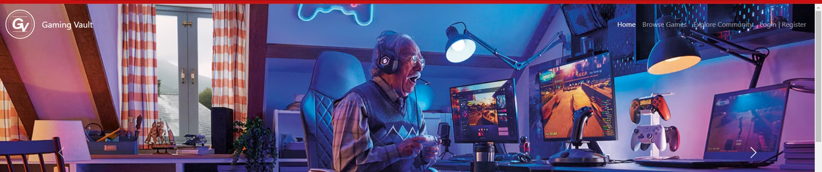



Fetch API Integration for Game Data
Data Source
Fetch API
Data Processing
A JSON file containing game data serves as the source for dynamic content.
The Fetch API retrieves data from the JSON file asynchronously, providing a seamless user experience.
Retrieved data is processed and displayed dynamically on the website, keeping content up-to-date.

Slide 8

Immersing Users in the Gaming World
Game Library
Leaderboards
A comprehensive game library allows users to explore a vast collection of games across different genres.
Leaderboards foster competition and recognition, encouraging users to strive for higher scores and rankings.
Community Forums
Forums provide a space for users to discuss their favorite games, share tips, and connect with other gamers.

Slide 9
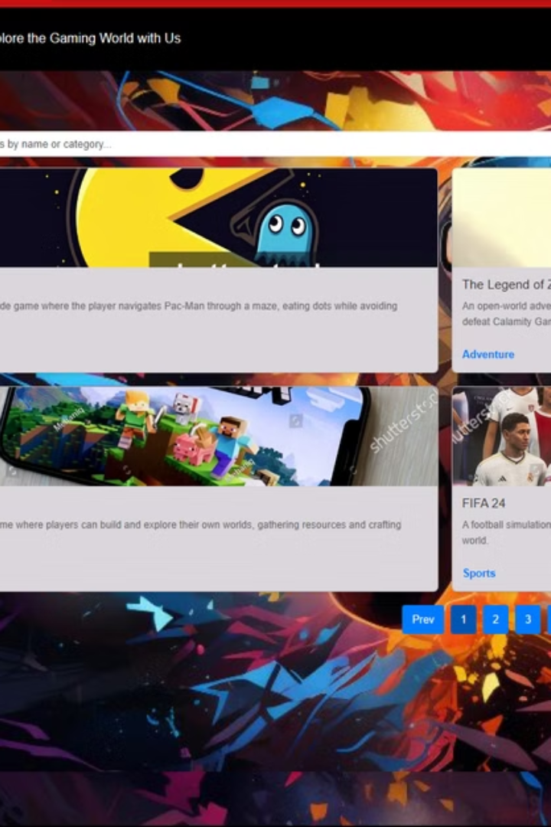
Conclusion and Key Takeaways
The Gaming Vault project demonstrates the power of webstack technologies in creating engaging and interactive platforms. By combining user-friendly design, dynamic content, and community features, the project offers a valuable resource for gamers of all levels.

Slide 10
THANK YOU

